Slide 1

EGYPTIAN TRAFFIC DATABASE PROJECT
SQL system for Egyptian vehicles registration and violations

Slide 2
PROJECT MEMBERS:
1-ZIAD SALAH ELAREF
2-ZIAD RADWAN ABDELMONEM
3-ZIAD MOHAMED FATHY
4-ZIAD WAEL HASSAN
5-MOHAMED OSAMA ABDELMONEM
6-SALEM AHMED SALEM
7-MOHAMED SHEHAB GAFAAR

Slide 3

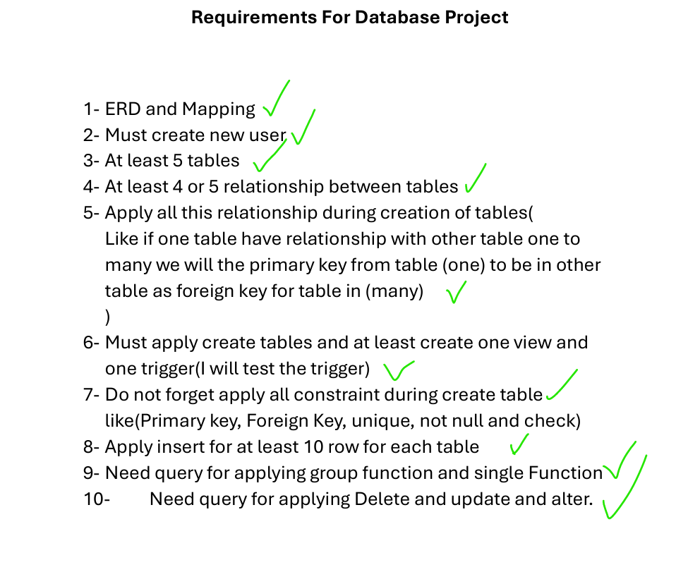
Introduction
This project outlines a professional SQL database design for the Egyptian Traffic system, covering all requirements
tables, erd mapping, trigger, and constraints functions updates.

Slide 4

01
System Overview

Slide 5

Objectives & Scope:
The traffic center centralizes
traffic officer ,
owner,
licensing,
vehicle,
and violation data
Key deliverables: reliable data model, enforcement of regulatory rules, and integration points for enforcement and reporting systems.

Slide 6
Egyptian Plate Logic: Alphanumeric format, governorate start letters, specialized plates (Police, Heavy Trucks, Diplomatic)
Plates follow 3 letters / 4 numbers; the first letter maps to a governorate (e.g., Cairo, Giza, Alexandria). The schema encodes a governorate lookup and validation rules.
ا ب ت .. = A B C
Specialized plates (Police, Heavy Trucks, Diplomatic) use dedicated type codes and constraints to ensure correct classification and access controls. (by color)

Slide 7
TRIGGER
Vehicles enforce registration expiration and inspection due dates with automated alerts and stat flags.
Violations are stateful records linked to vehicles and owners; repeat offenses trigger escalation
rules and license holds.
Use data integrity constraints and scheduled jobs to enforce renewals, inspections,
and penalty workflows.

Slide 8
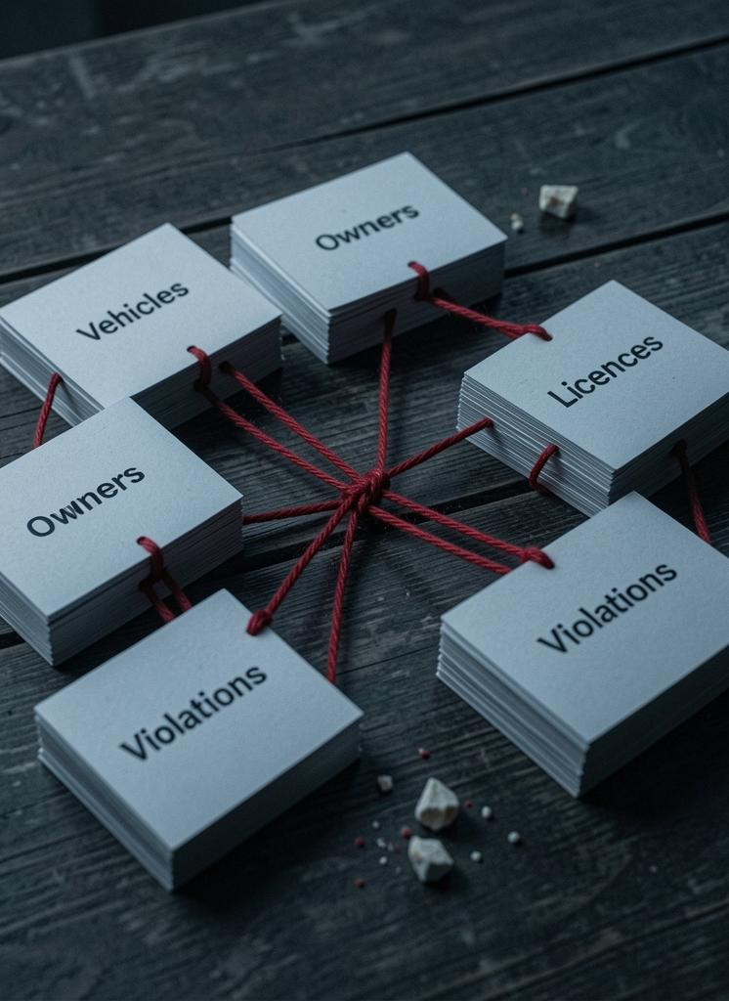
02
Data Model

Slide 9

Traffic Officers, Cars Car Owners, Violations:
primary/foreign key
WE Defined primary keys for each entity and use foreign keys for relationships: Owner-Car, Car-Inspection, Car-Violations, Officer-Violations.
Include composite keys where needed (plate + governorate)

Slide 10
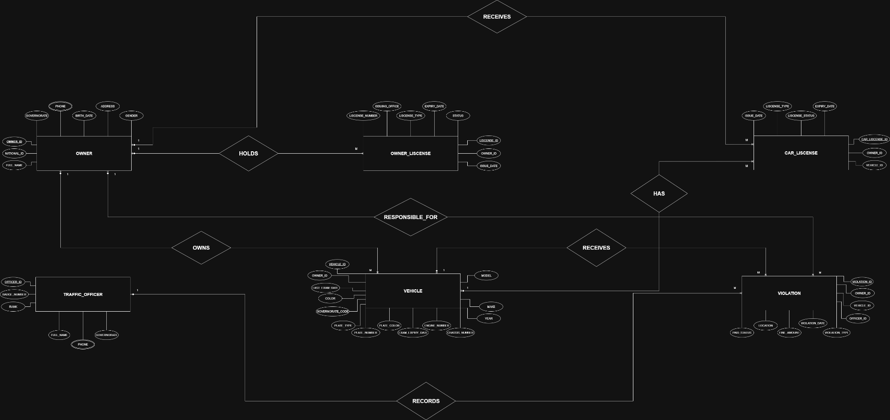
Entity Relationship Diagram (ERD)

Slide 11
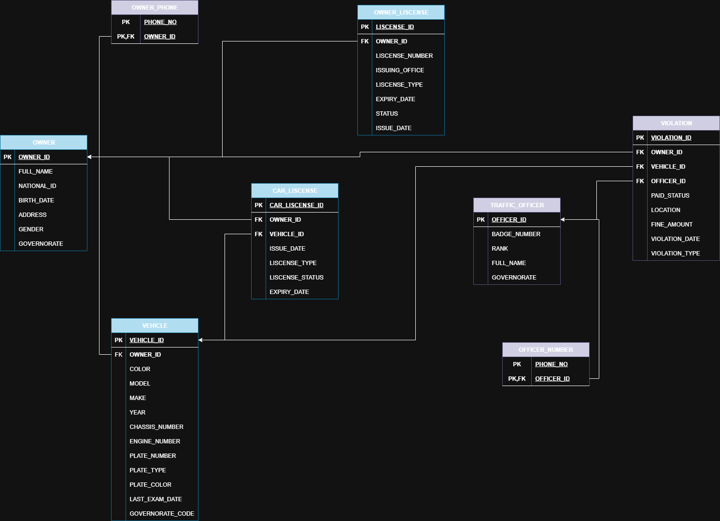
Relational Mapping/Schema

Slide 12
Conclusions
The proposed schema centralizes vehicle, owner, licensing, inspection, and violation data to support enforcement and reporting.
Designed for scalability, regulatory compliance, and operational integrity with clear extension points for analytics and integrations.

